Slide 1

SRI VENKATESWARA UNIVERSITY COLLEGE OF ENGINEERING
BACHELOR OF TECHNOLOGY
in
COMPUTER SCIENCE AND ENGINEERING
DIABETES DETECTION USING THERMAL FOOT IMAGING AND MOBILENET-BASED DEEP LEARNING
Under the Esteemed Guidance of
P. Hima Chandana
Academic Consultant

Slide 2
ACKNOWLEDGEMENT
We express our deep sense of gratitude to our guide of the project and mentor P. Hima Chandana,Academic Consultant, Department of Computer Science And Engineering at Sri Venkateswara University College of Engineering for her valuable guidance, thought-provoking discussions, and invigorating suggestions extended to us with immense care and zeal throughout the project.
Our sincere thanks are due to Dr. D. Vivekananda Reddy, Head, Department of Computer Science And Engineering, Sri Venkateswara University College of Engineering for his encouragement and continuous support extended during the period of this project work.
Lastly, we would like to thank all our friends and people who helped directly or indirectly to do this work.
- Sincerely,
Chandramouleshwar J 12116013
Kalluri Nikitha 12116030
Mocharla Harshini 12116048

Slide 3
PRESENTATION OUTLINE
Abstract
Introduction
Objectives
Model Used
Existing and Proposed System
Methodology
Architecture of the model
Filters Used in Processing
Result
Future Enhancements
Real World Applications
Conclusion
References

Slide 4
ABSTRACT
Diabetes mellitus is a widespread metabolic disorder that can lead to severe complications like diabetic foot ulcers (DFU), increasing the risk of infections and amputations.
Traditional diagnostic methods are often invasive, time-consuming, and prone to human error, highlighting the need for an advanced, non-invasive detection system.
This project leverages deep learning and thermal imaging to develop an AI-powered diagnostic tool for early DFU detection.
Using Convolutional Neural Networks (CNNs), particularly MOBILENETV2, the system analyzes thermal foot images, identifying temperature variations associated with diabetic complications.

Slide 5
ABSTRACT
Early identification of these complications is crucial, but existing diagnostic methods are invasive, time-consuming, and prone to inaccuracies.
Our project introduces an AI-based, non-invasive solution utilizing thermal imaging combined with a lightweight deep learning model, MobileNetV2.
Thermal foot images are analyzed to detect abnormal heat patterns associated with diabetic foot ulcers and other complications.
The proposed system enhances diagnostic efficiency by providing automated predictions, minimizing human error, and speeding up the screening process.
The ultimate goal is to offer an accessible and reliable tool to assist healthcare providers in the early detection and management of diabetic foot conditions.

Slide 6
INTRODUCTION
The Diabetes Detection System is an AI-powered software application designed to assist in the early detection of diabetes and diabetic foot ulcers (DFU) using thermal imaging.
The system provides a non-invasive and automated approach to analyzing foot thermograms, helping healthcare professionals diagnose diabetes-related abnormalities efficiently.
It is developed to streamline the diagnostic process, reduce human error, and improve accessibility to early diabetes screening.
This project focuses on building a web-based application that integrates deep learning models for thermal image analysis, enhancing accuracy and reliability.
The system is expected to provide the following features:
Thermal image data collection and management.
Patient registration and management.
Patient login for accessing reports.

Slide 7
INTRODUCTION
Diabetes Mellitus is a major global health concern, affecting millions worldwide.
One of the severe complications of diabetes is the development of Diabetic Foot Ulcers (DFUs).
Early detection of diabetic foot abnormalities is critical to prevent serious outcomes like infections and amputations.
Traditional diagnostic methods are:
Invasive (require physical examination or tests),
Time-consuming,
Subject to human error and variability.
Thermal Imaging offers a non-invasive method to detect abnormal temperature patterns associated with diabetic complications.

Slide 8
OBJECTIVES
The objects of a Diabetes Detection system may include:
CNN-Based Model Development: The system should design and implement a MobileNetv2-based deep learning model to analyze thermal foot images and detect temperature variations indicative of diabetic foot ulcers.
Model Training on a Comprehensive Dataset: The system should be trained on a large dataset of thermal foot images, including both healthy and ulcer-affected feet, with preprocessing and augmentation to enhance detection accuracy.
Performance Optimization: The system should employ hyperparameter tuning, regularization techniques, and data augmentation to improve accuracy, efficiency, and robustness in ulcer detection tasks.
Real-World Usability Assessment: The system should be tested under various conditions, including different lighting, skin tones, and foot positions, ensuring adaptability for hospitals, clinics, and remote healthcare settings.

Slide 9
OBJECTIVES
To design and implement a MobileNetV2-based deep learning model for analyzing thermal foot images.
To develop a non-invasive diagnostic system capable of early detection of diabetic foot complications.
To enhance model accuracy through data preprocessing, augmentation, and fine-tuning techniques.
To create a user-friendly web interface for uploading foot images and generating diagnostic reports.
To evaluate system performance using metrics like accuracy, precision, recall, and F1 score.

Slide 10
MODEL USED - MOBILENETV2
What is MobileNetV2?
A lightweight deep learning model optimized for mobile and edge devices.
Developed by Google in 2018, improving upon MobileNetV1.
Designed for fast, efficient, and accurate image classification & object detection.
Key Innovations:
Depth wise Separable Convolutions – Reduces computation compared to traditional CNNs.
Inverted Residual Blocks – Efficient feature extraction with residual connections.
Linear Bottleneck – Prevents information loss, improving accuracy.
Fewer Parameters – Only 3.4M parameters, making it memory-efficient.
Where is MobileNetV2 Used?
Real-time Object Detection – Used in TensorFlow’s SSD-MobileNet.
Face Recognition – Google’s FaceNet.
Medical Imaging – Diabetic detection, X-ray classification.
AI in Robotics – Lightweight AI models for drones & automation.

Slide 11
EXISTING SYSTEM – DIABETES PREDICTION SYSTEM
Most existing diabetic prediction models rely on:
Traditional Machine Learning Approaches:
Algorithms Used: Logistic Regression, Decision Trees.
Data Used: Mostly tabular data from structured medical records (e.g., PIMA Indian Diabetes dataset).
Limitations:
Accuracy is highly dependent on feature selection.
Requires extensive manual preprocessing of medical data.
Struggles with real-world generalization due to dataset limitations.
Deep Learning-Based Approaches:
CNN-based Models: Some research integrates CNNs with fundus images, foot images, or X-rays.
Challenges:
Large dataset requirements.
Risk of over-fitting due to limited diabetic-specific image datasets.

Slide 12
PROPOSED SYSTEM – KEY FEATURES
Deep Learning-Based Model:
Utilizes MobileNetV2 with transfer learning for high accuracy & efficiency.
Supports fine-tuning with dropout & L2 regularization for better generalization.
Thermal Image Analysis:
Uses foot thermal images instead of fundus images or tabular data.
Provides non-invasive detection of diabetes.
Feature Extraction for Enhanced Classification:
Combines CNN-based features with GLCM texture & temperature-based features.
Extracts deep spatial & thermal patterns for precise classification.
Advanced Training Strategies:
K-Fold Cross-Validation to improve model generalization.
Class Weight Adjustment to handle class imbalance.
Early Stopping & Learning Rate Scheduler to optimize training.

Slide 13
PROPOSED SYSTEM - ARCHITECTURE
Data Processing & Model Training:
Preprocessing :
Loads raw thermal images from diabetic & non-diabetic datasets.
Resizes to 224x224 for CNN input compatibility.
Data Splitting :
Divides dataset (70% Train, 20% Validation, 10% Test) for better generalization.
Model Training:
Uses MobileNetV2 as the base model with a custom dense layer head.
Fine-tuning in 3 stages
(Head Training → Partial Fine-tuning → Full Fine-tuning).
Augments training with dropout, regularization & learning rate adjustments.
Prediction & Evaluation:
Grad-CAM visualization to highlight affected diabetic regions.
Generates a detailed classification report & confusion matrix for performance analysis.

Slide 14
WORKFLOW OF THE METHODOLOGY
DATA COLLECTION
DEPLOYMENT
DATA PREPROCESSING
DATA SPLITTING
MODEL IMPLEMENTATION AND TRAINING
FEATURE EXTRACTION
EXERCISE RECOMMENDATION
TESTING
APPLICATION DEVELOPMENT
Fig : Flow chart of the Methodology
Data Collection : Gather thermal images of the foot for analysis.
Data Preprocessing: Resize ,normalize and enhance image quality.
Data Splitting : Divide data into training ,validation and testing sets.
Model Implementation and training : Train a mobile net-based deep learning model.
Feature Extraction : Extract key temperature based features for classification.
Exercise Recommendation : Suggest personalized exercise for diabetic patients.
Application Development : Develop a user friendly interface for predictions.
Testing and Deployment : Evaluate the models accuracy and performance. Deploy the system for real world usage.

Slide 15
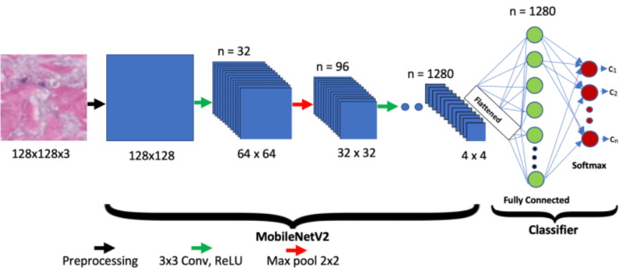
ARCHITECTURE OF THE MODEL
Fig:MobileNetV2-Based Model Architecture for Diabetes Detection

Slide 16
ARCHITECTURE OF THE MODEL
1.Input Layer:
Resized thermal foot images (128x128x3).
2.Convolutional Layers:
3x3 convolutions followed by ReLU activation.
Feature extraction using depthwise separable
convolutions.
3.Pooling Layers:
2x2 Max pooling to reduce spatial dimensions.
4.MobileNetV2 Core:
Inverted residuals and linear bottlenecks for efficiency.
Fully Connected Layer:
Dense layer with softmax activation for final classification.
5.Output:
Predicts diabetic or non-diabetic foot condition.

Slide 17
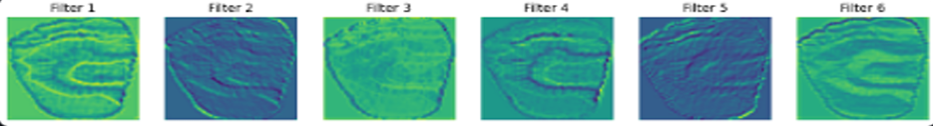
FILTERS USED IN PROCESSING
Fig :Filters used in the processing.
Filter 1:
Captures broad temperature distribution patterns
across the entire foot.
Highlights general hot and cold areas.
Filter 2:
Focuses on edge detection.
Sharpens foot contours and separates
different temperature zones.
Filter 3:
Enhances localized thermal anomalies.
Useful for spotting small hotspots or cooling patches.
Filter 4:
Detects medium-scale textures and transitions between temperature regions.
Helps in analyzing asymmetrical patterns between different foot areas.

Slide 18
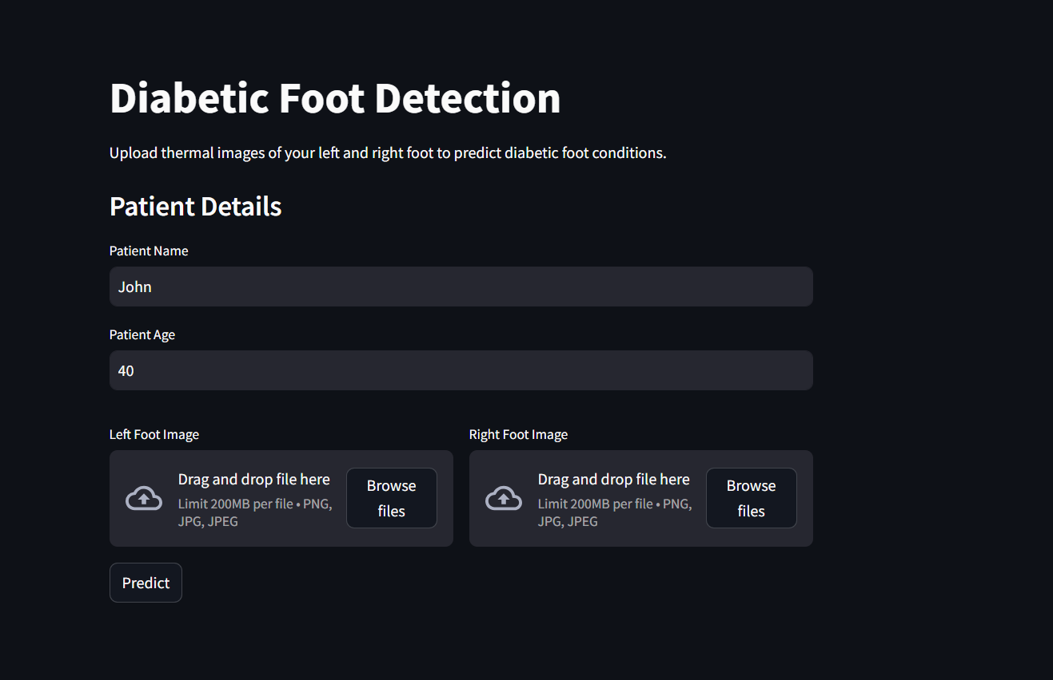
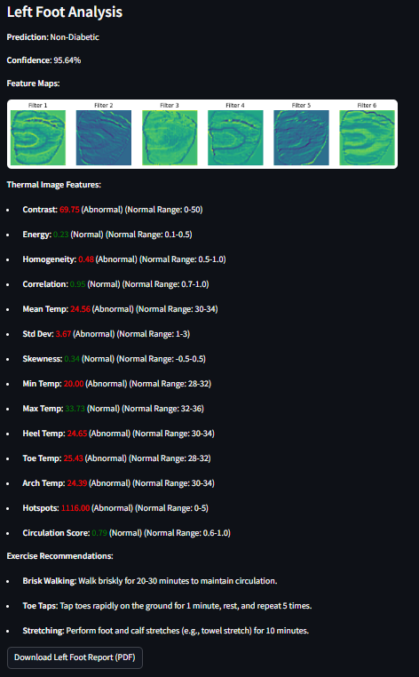
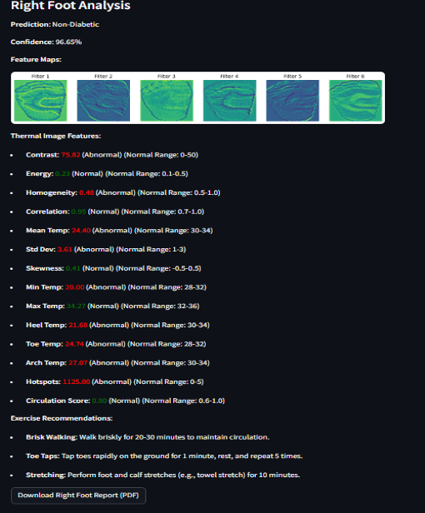
RESULT
Fig: Website to upload the Left and Right Foot of the patient.
Fig : Demonstrating the Left Foot Analysis of the patient.
Fig: Demonstrating the Right Foot Analysis
of the patient.

Slide 19
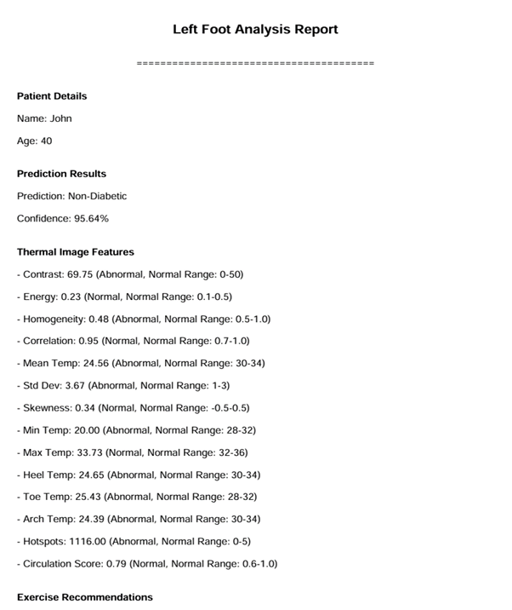
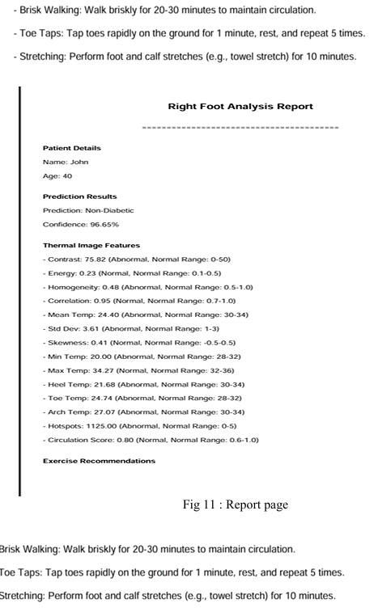
RESULT
Fig: Downloaded Report of the Left Foot Analysis.
Fig: Downloaded Report of the Left Foot Analysis.

Slide 20
FUTURE ENHANCEMENTS
Enhanced Feature Extraction – Incorporate advanced techniques like attention mechanisms or transformer-based architectures to improve feature extraction from thermal images.
Integration with Wearable Devices – Extend the system to work with thermal sensors in wearable devices for real-time diabetic foot monitoring.
Multi-Model Analysis – Combine thermal imaging with other diagnostic modalities like ultrasound, pressure mapping, or blood glucose levels for improved accuracy.
Larger and More Diverse Dataset – Expand the dataset with images from different demographics to improve generalizability and robustness of the model.
Explainable AI (XAI) Implementation – Integrate explainability methods to help healthcare professionals understand the model’s predictions and decision-making process.

Slide 21
FUTURE ENHANCEMENTS
Cloud Integration for Large-Scale Access:
Deploy the model on cloud platforms (AWS, GCP) for real-time global usage.
Mobile Application Development:
Create a lightweight Android/iOS app for easier patient and doctor access.
Real-Time Alerts:
Send notifications for abnormal foot temperature readings.
Collaboration with Hospitals:
Integrate into existing hospital management systems for automated reports.
Continuous Learning System:
Keep updating the model with new patient data to improve over time.

Slide 22
REAL WORLD APPLICATIONS
Early Screening Camps:
Use in rural and remote health camps for quick diabetic foot screenings without invasive methods.
Hospitals and Clinics:
Assist doctors by providing fast thermal image analysis for early diagnosis and patient monitoring.
Home Monitoring Systems:
Integration with wearable thermal sensors for daily foot health tracking in diabetic patients.
Telemedicine Services:
Allow patients to upload foot images remotely and receive instant preliminary diagnosis reports.
Health Awareness Programs:
Support campaigns promoting early detection and prevention of diabetic complications through easy AI tools.

Slide 23
CONCLUSION
The project ‟Diabetes Detection using Thermal Images and MobileNetV2” successfully demonstrates the effectiveness of thermal imaging and deep learning in detecting diabetes and foot ulcers. By leveraging MobileNetV2, we achieved an efficient and lightweight model capable of accurately classifying diabetic and non-diabetic foot images. The system not only automates the diagnosis process but also integrates feature extraction and personalized exercise recommendations to assist in patient care.
The developed model, when deployed in a real-world healthcare environment, can aid in early detection and continuous monitoring of diabetic foot complications. With further improvements such as real-time processing, integration with wearable devices, and multi-modal data analysis, this approach can revolutionize non-invasive diabetes diagnosis.
Future work will focus on expanding the dataset, optimizing model performance, and enhancing accessibility through mobile and cloud-based deployment. This project lays the foundation for a scalable, AI-powered healthcare solution aimed at improving diabetic care and reducing complications through early detection and personalized interventions.

Slide 24
REFERENCES
[1].https://www.sciencedirect.com/science/article/abs/pii/S0010482518300738?via%3Dihub.
[2]. http://qirt.gel.ulaval.ca/archives/qirt2023/papers/QIRT-ASIA-2023_paper_27.pdf
[3]. https://www.thelancet.com/journals/lancet/article/PIIS0140-6736(05)67698-2/abstract
[4].https://www.researchgate.net/publication/362285268_A_Deep_Learning_Method_for_Early_Detection_of_Diabetic_
[5]. https://arxiv.org/abs/2106.14207
[6].https://aaasjournals.com/index.php/ajapas/article/view/824?utm_source=chatgpt.com
[7]. https://pmc.ncbi.nlm.nih.gov/articles/PMC10744680/
[8]. https://pmc.ncbi.nlm.nih.gov/articles/PMC6945006/

Slide 25
THANK YOU

